Slide 1
National Honor Society

Slide 2
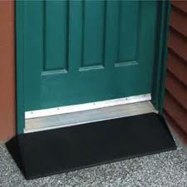
3.500 cumulative GPA is the threshold for membership consideration.
Notes:
It just gets you in the door.
Having a very high GPA does not make you more eligible for membership.
Your GPA has no more influence on eligibility for membership.
We are going to talk about 4 aspects of the NHS process.

Slide 3
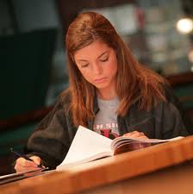
Completing the application
DUE DATE: Thursday, May 11th
Notes:
There are 6 pages to complete.
Application is available on the Beca website. Go to Academics tab, NHS, Application.

Slide 4
Leadership
Club, activity, or band officer
Team captain
Student Council officer or representative
Retreat team leader
Peer listener
Yearbook editor
Hawk Ambassador
CYO coach
Founder of a club or activity
Attendee at leadership conference
Director, writer, or producer for feeder school play
Camp counselor
Science Fair mentor
Scout projects
Vacation Bible Study or CCD teacher
Notes:
Positions can be held at Beca or in the community
Do not include membership in Who’s Who

Slide 5
Service
List service along with dates and hours that are beyond theology requirement. Please include total number of hours. List service with most hours first.
Do not list any service for which you have been paid.
Service must have occurred in high school.

Slide 6
ACTIVITIES
List activities in order of length of involvement, longest involvement first.
List only activities in which you have been involved during high school.

Slide 7
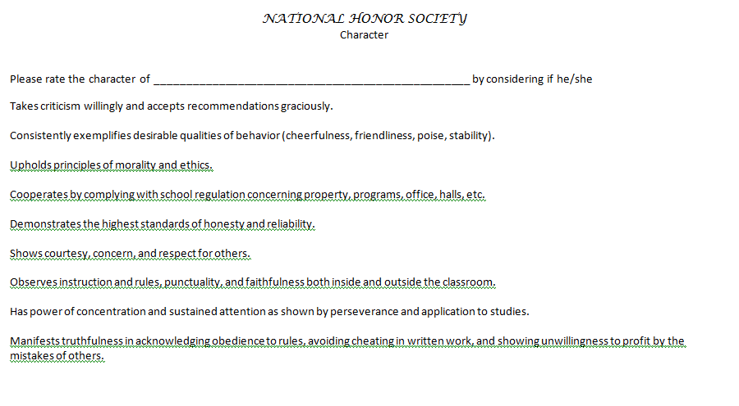
CHARACTER
Notes:
The fifth page is character.
These are qualities that NHS feels are important for membership.
The teachers use this page to evaluate your character.
Only put your name.

Slide 8
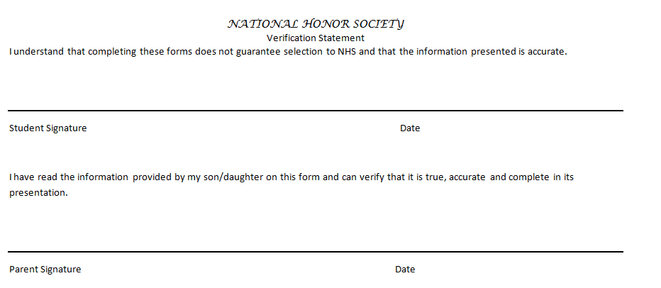
VERIFICATION STATEMENT
Notes:
The last page is the verification statement.
Make sure you and a parent sign it indicating that all the infomation on the application is true.

Slide 9
WHAT TO DO NEXT
Complete your application.
Print your completed application and submit it to Mrs. Eick on or before Thursday, May 11th.
Select your evaluators: Ask three (3) current teachers of major subjects* and three (3) other faculty members or administrators to evaluate your application.
*A major subject is a class that meets each day of the cycle.
Email your application to Mrs. Eick and Cc your chosen six (6) evaluators on or before Thursday, May 11th.
Notes:
Mr. Petruzzelli, Mrs. Young, Mr. Henrich, and Mrs. Peoples may evaluate or write a letter for you.

Slide 10
Remember the application deadline, May 11th!
Fill out the application carefully. Teachers do not necessarily know everything about you and must be able to evaluate you from the application.
List accomplishments only once; no repeats.
All leadership, service, and activities must have been performed while in high school.
If you have any questions, see Mrs. Eick before submitting application.
Notes:
Don’t fight the forms: You do not have to fill in every rectangle and if you need more space, make another copy.
Any of the NHS Council members or I will be glad to critique your application before you finalize it.

Slide 11
NHS Selection
The NHS Faculty Council selects members based on teacher evaluations and applications.
Members of NHS Faculty Council are:
Mrs. Eick
Mr. Grasso
Mr. Messina
Mrs. Ruth
Mrs. Rutherford
Mr. Tomaszewski
Notes:
I am not a member of the faculty council.
I am not allowed to fill out a teacher evaluation or write a letter of recommendation for you.
The Faculty Council members may do both.

